Slide 1
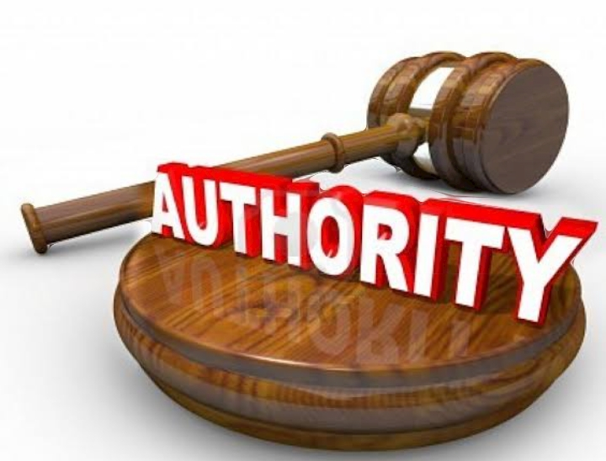
CONCEPT OF AUTHORITY

Slide 2
Meaning and Definition of Authority
Meaning of Authority:- Authority refers to the legal and formal to give commands and make decisions .For example, a manager has the authority to revise employees’ work schedules based on the needs of the company.
Definitions
According to Beach , “Authority is legitimate right to direct or influence the work of others.”
According to Robert A. Dahl , “Legitimate power is often called authority.”

Slide 3
Characteristics of Authority
Authority is a Quality
Capacity to command and obedience
Accepted and Respected
Authority is Legitimate
Authority is Relational
Authority is not something Material
Basis of authority is Reason
Organisation
Hierarchical nature of authority
Authority is situational concept
Accountability

Slide 4
Traditional Authority
Authority of Elite
Legal Authority
Political Authority
Kinds of Authority
Authority based on Force
Charismatic Authority
Religious Authority

Slide 5
Basis of Authority
Legitimacy
Public opinion
Ancestral Lineage
Legal Force
Traditions
Utility
Religion
Habits
Constitution

Slide 6
IMPORTANCE OF AUTHORITY
Authority provides legitimacy to power
Check on the principle of might is right
Authority brings efficiency in administration
Authority provides stability to administration
Administration becomes less Expensive

Slide 7
THANK YOU

